Slide 1
Recent changes in Income Tax law as applicable to NGOs
Compiled by
CA. PRASANTH SRINIVAS
S. S. AYYAR & CO., CHARTERED ACCOUNTANTS, KOTTAYAM
Phone: 9447125731 E-mail: ssayyarandco@gmail.com

Slide 2
Finance Act, 2016
Section 35 AC phased out w.e.f financial year 2017-18
Concept of exit tax to charitable / religious institutions registered u.s. 12 AA / 12 A introduced (Chapter XII EB)
Sections 115 TD to 115 TF inserted w.e.f. 01.06.2016
Exit tax is attracted on
Winding up
Merger with other institution
Conversion (cancellation of registration and modification of objects without taking fresh registration are also deemed as conversion)
Exit tax = accreted income x maximum marginal rate
Accreted income is by and large the fair market value of residual assets – Please refer Rule 17 CB
https://taxguru.in/income-tax/analysis-provisions-related-tax-accreted-income-trusts-institutions.html
Tax on accreted income shall be paid as prescribed in Chapter XII EB
This chapter is a sword hanging above the head and utmost care should be exercised while furnishing replies in scrutiny assessments

Slide 3
Finance Act, 2017
Corpus donation to an entity registered under section 12 A / 10 (23 C) by another such registered entity – the donor cannot claim the said donation as application of income – however, it continues to be exempt in the hands of the recipient (w.e.f. A Y 2018-19)
An entity registered under section 12 A / 12 AA – subsequently modifies the objects – against the conditions of registration – it shall be required to obtain fresh registration by making an application within 30 days of such modification (w.e.f. A Y 2018-19)

Slide 4
Finance Act, 2017 (contd…)
Section 12 A further amended – registered entity shall file return of income within the due date under section 139 (1) – if return not filed within the time allowed u.s. 139 (1), exemption u.s. 11 / 12 will not be available (w.e.f. AY 2018-19)
No deduction shall be allowed u.s. 80 G (w.e.f. AY 2018-19) in respect of donation of any sum exceeding Rs. 2,000 (earlier Rs. 10,000) unless such sum is paid by any mode other than cash
Section 269 ST – w.e.f. 01.04.2017 – cash receipt – restrictions - Rs. 2 lakhs per day per transaction or per event etc., as the case may be – penalty u.s. 271 D – sum equal to the amount received in cash (except in case of compelling necessity)

Slide 5
Finance Act, 2018
Section 40 (a) (ia) and section 40 A (3)
Present position – for availing exemption u.s. 11 or 10 (23C), there was no restriction on payments made in cash or by bearer cheque. Likewise, there was no check on whether such entities comply with TDS provisions.
Proviso inserted in section 10 (23C) and explanation added in Section 11 (w.e.f. AY 2019-20) – for the purpose of determining the application of income, the provisions of sections 40 (a) (ia) and 40 A (3) / 40 A (3A), shall mutatis mutandis apply as they apply in computing Business / Professional income
Points
40 (a) (i) and 40 (a) (iii) are not covered
Since restrictions apply vis-à-vis application of income, both capital and revenue expenses are covered
Religious institutions while conducting festivals have to be extra cautious
Similar restrictions are also there in FCR Rules.
Saving grace is position till AY 2018-19 is settled.

Slide 6
Recent Circulars / Notifications
Notification dated 14.01.2016 – w.e.f. AY 2016-17 – Form 10 (section 11(2)) and Form 9 A (explanation to section 11 (1)) – new Forms notified and e-filing with DSC / EVC made mandatory
Circular dated 20.12.2018 – condonation of delay u.s. 119(2)(b) in filing Form 10 / 9A for AY 2016-17 (1st year of e-filing) – power given to CIT to condone the delay provided reasonable cause is shown for the delay in filing
Notification dated 19.02.2018 – Form 10 A for registration u.s. 12 AA – new Form notified and e-filing with DSC / EVC made mandatory

Slide 7
Recent Circulars / Notifications (contd…)
Form 13 – Application for nil or lower rate of TDS u.s. 197
Notification dated 25.10.2018 made e-filing of Form 13 mandatory in TRACES under DSC / EVC
Vide order dated 24.12.2018, CBDT permitted physical filing of Form No. 13 till 31.12.2018 for residents and till 31.03.2019 for non-residents
Notification dated 31.12.2018 lays down procedure for e-filing Form 13 in TRACES
Draft Notification dated 29.10.2018 – proposal to amend Rules 2C, 2CA (section 10(23C)) and Rule 11AA (section 80 G) and Form Nos. 10G, 56 and 56G – proposed Rules and Forms provide for e-filing with DSC / EVC (awaiting public comments)

Slide 8
Recent development in FCRA
DARPAN ID from Niti Aayog for the institution mandated for filing FC Annual return
Many institutions especially those renewed FC registration on the strength of Section 12 A certificate are yet to get DARPAN ID
On escalating the matter, vide communication dated 29.12.2018, MHA extended the due date for filing FC 4 Annual Return for the year 2017-18 from 31.12.2018 to 31.03.2019 (No. II / 21022 / 58 (370) / 2018 – FCRA (MU))

Slide 9
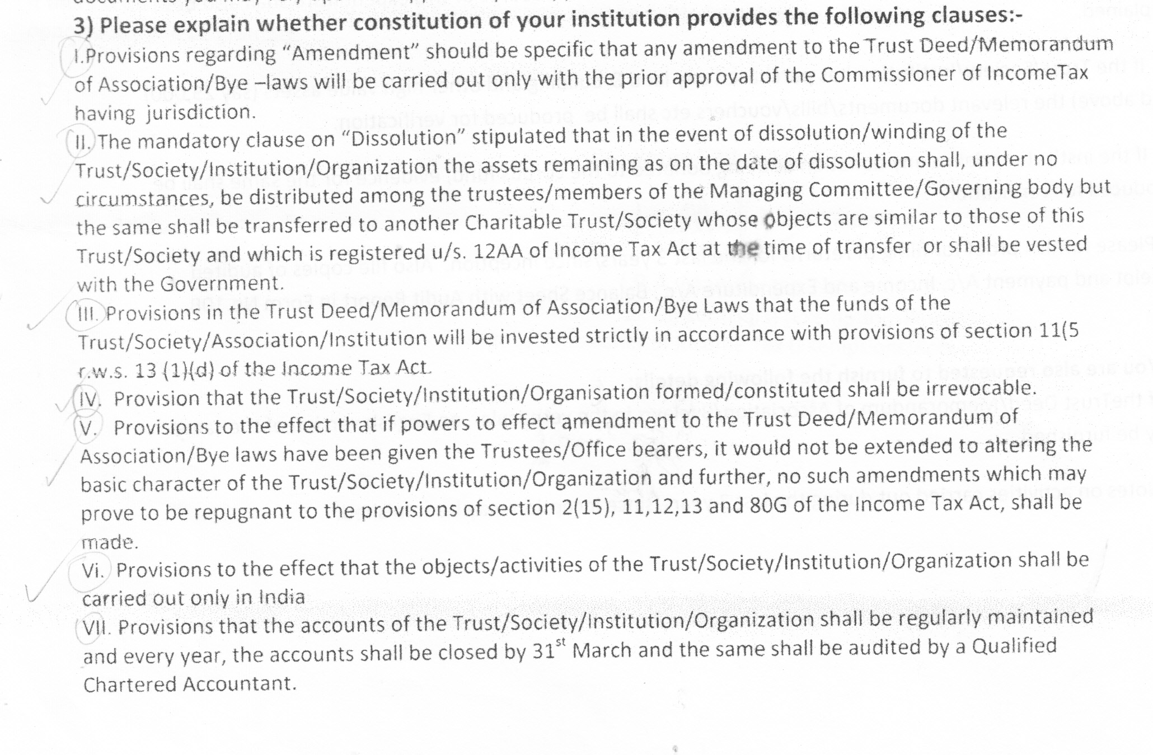
Matters required to be incorporated in Trust Deed etc for registration u.s. 12 A / 80 G

Slide 10
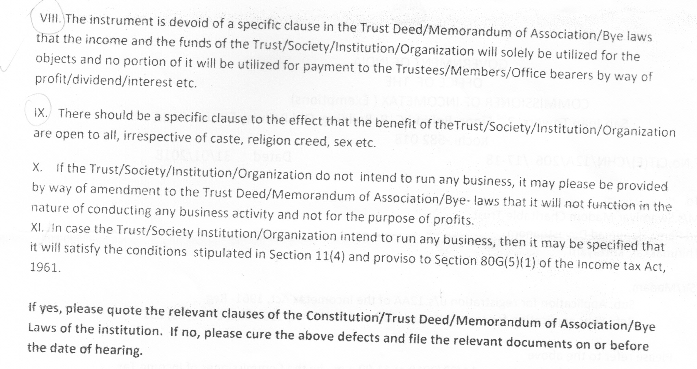
Matters required to be incorporated in Trust Deed etc for registration u.s. 12 A / 80 G (contd..)

Slide 11
For your valuable feed back
THANK YOU…

